Slide 1
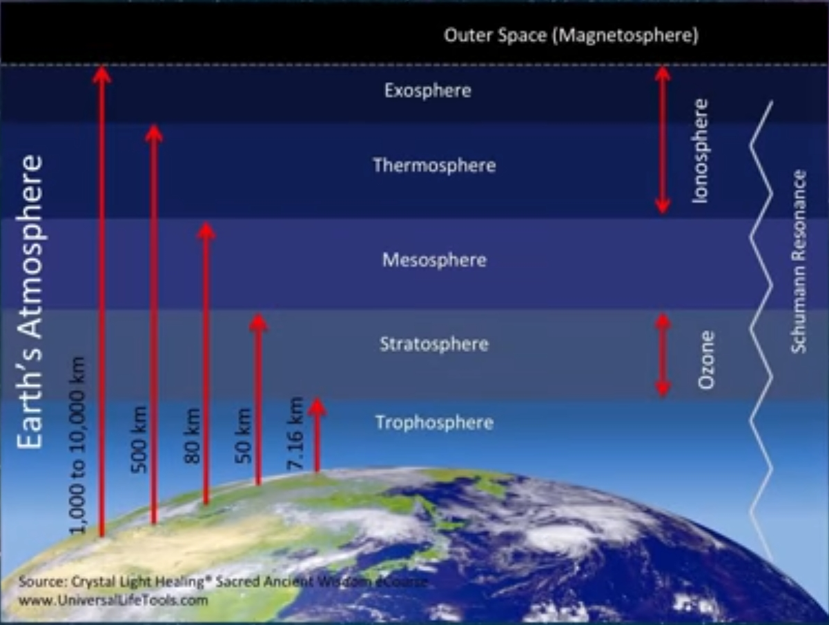
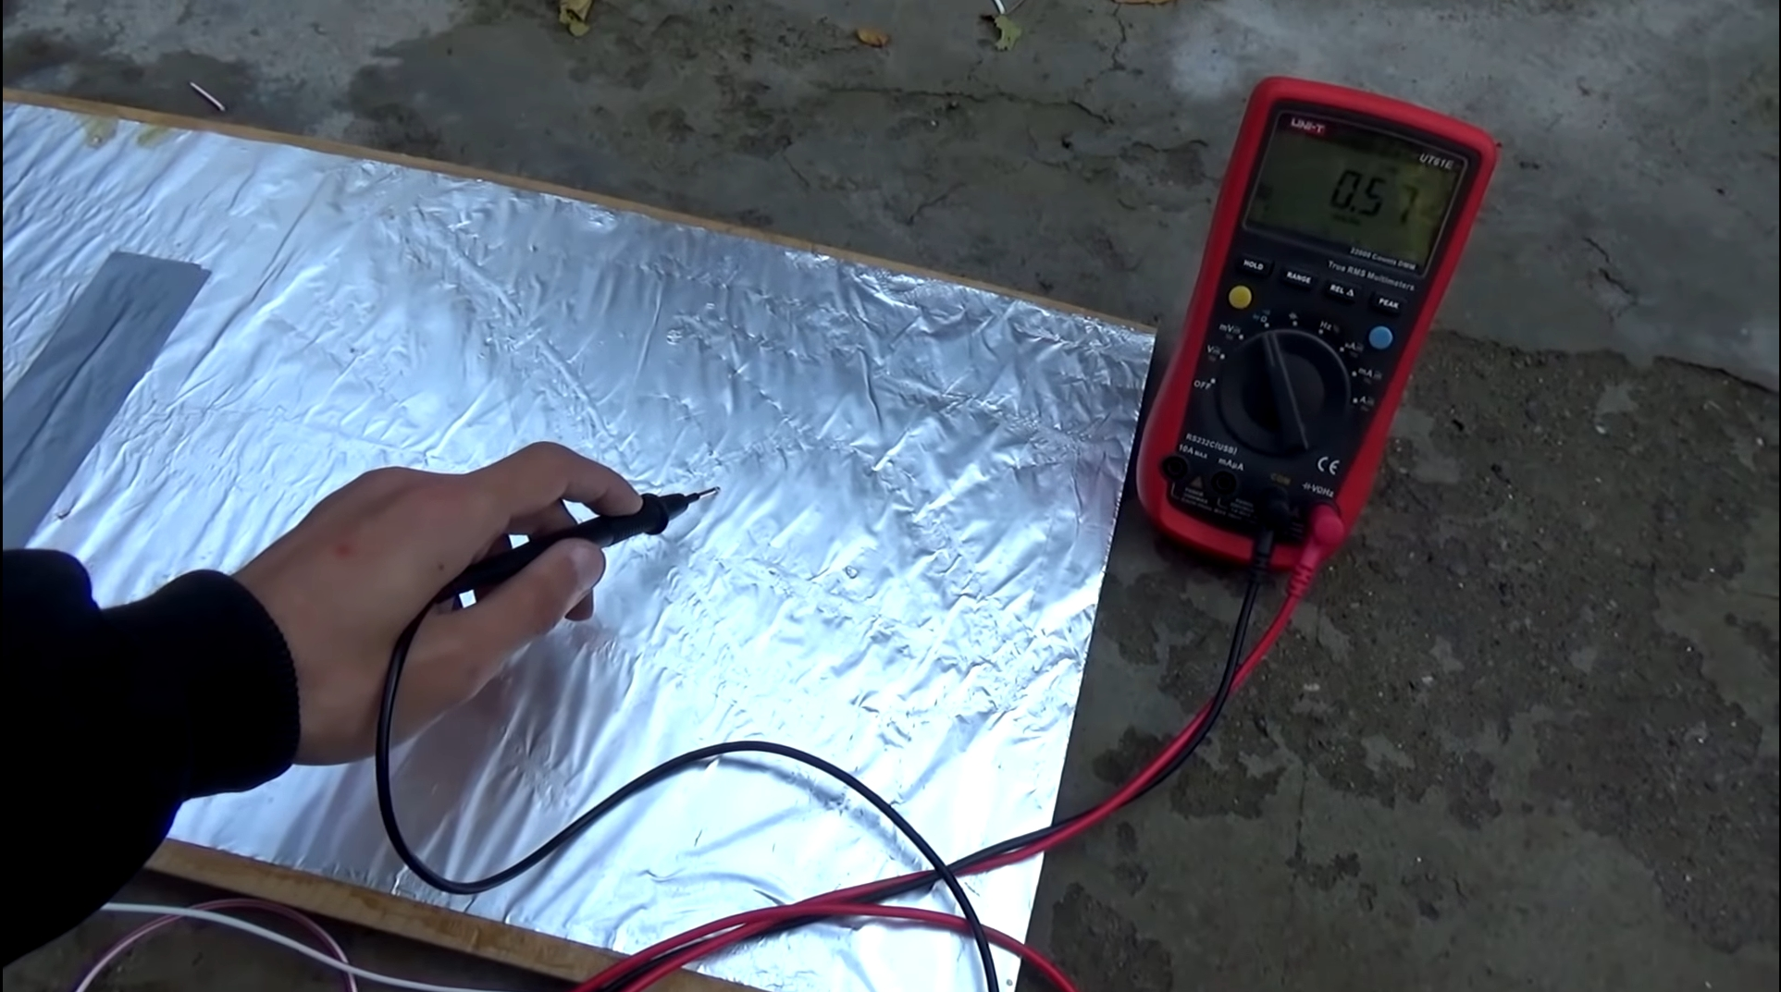
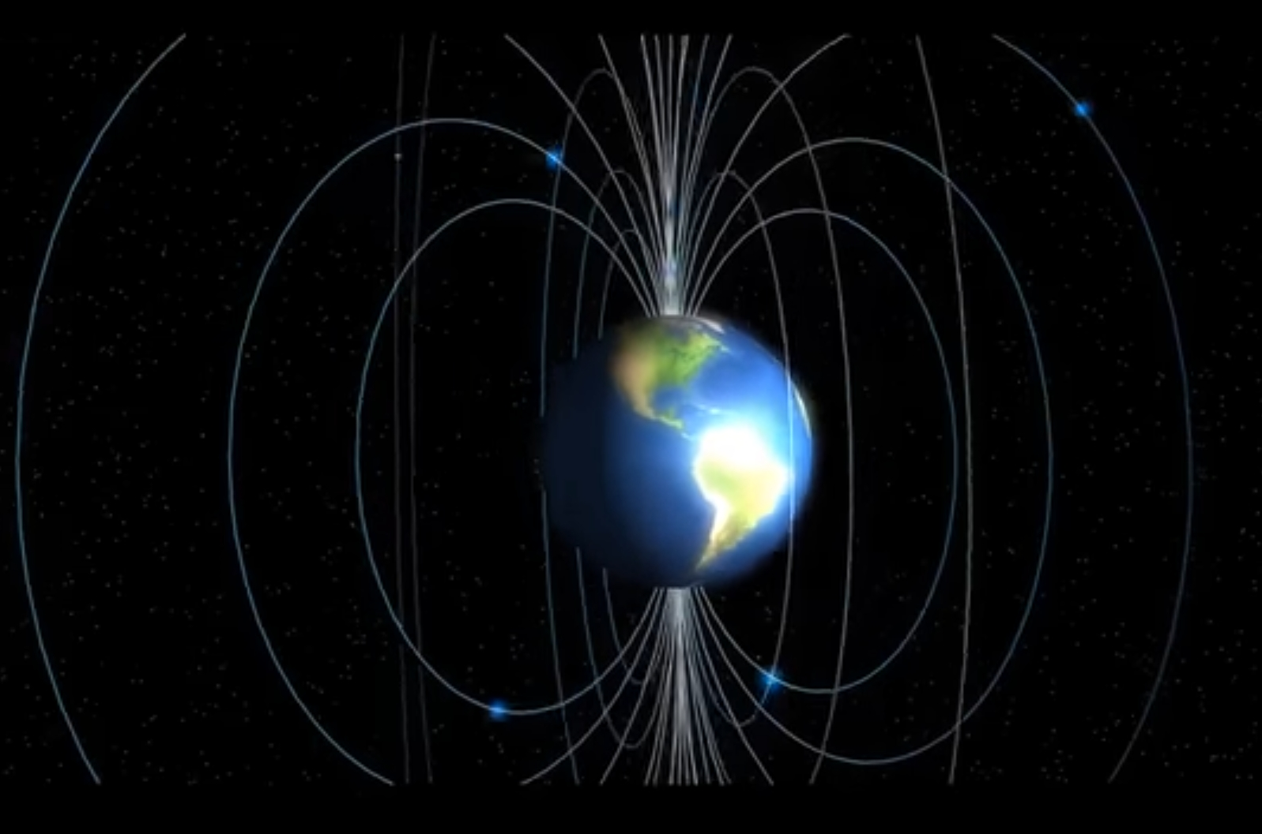
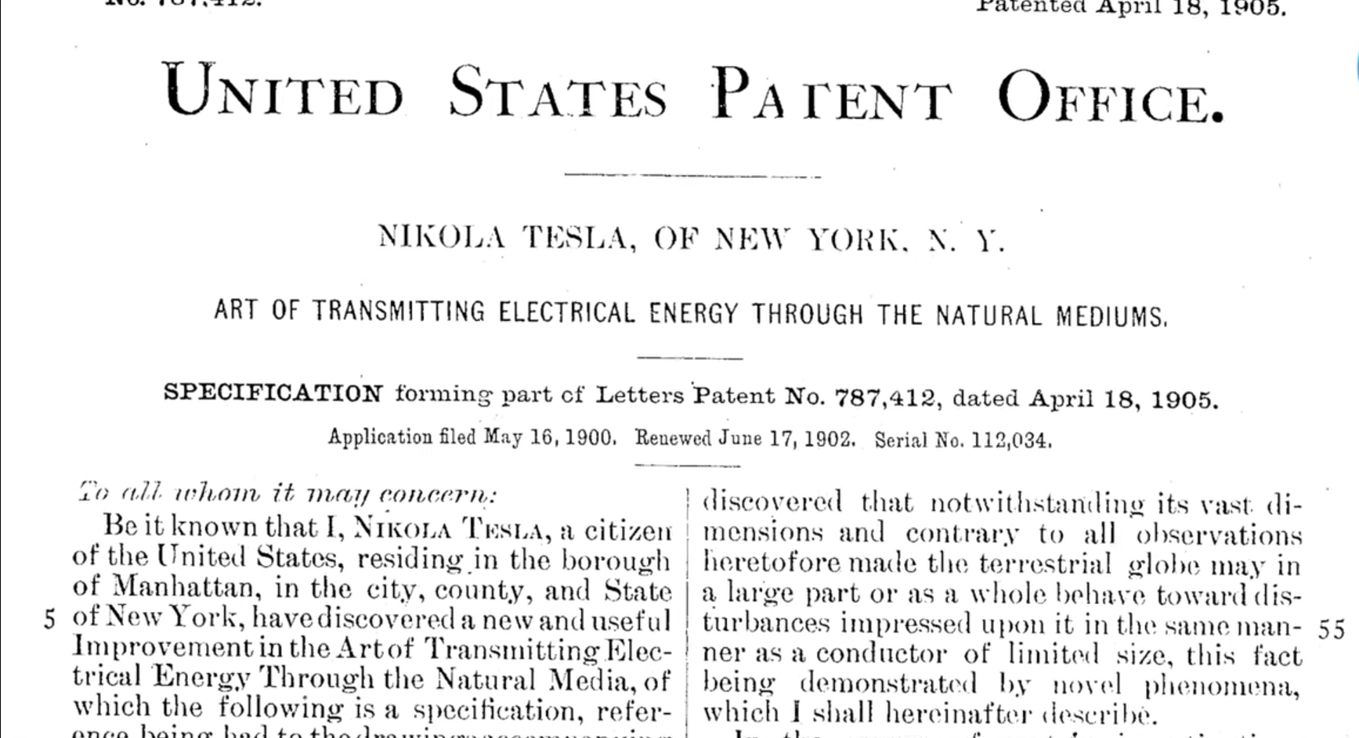
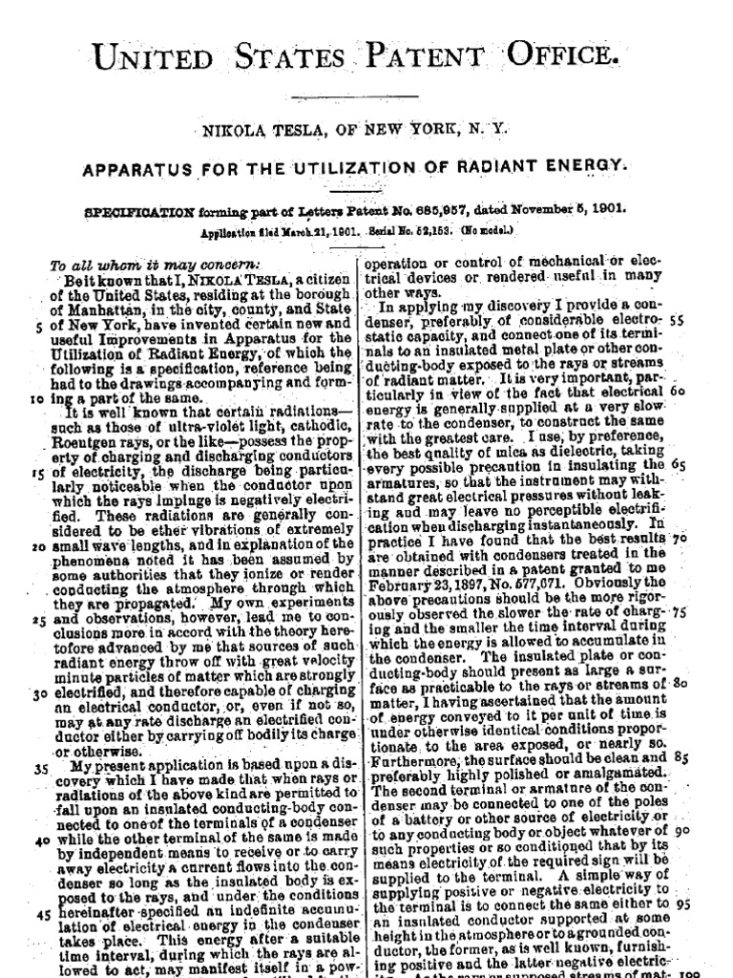

Slide 2
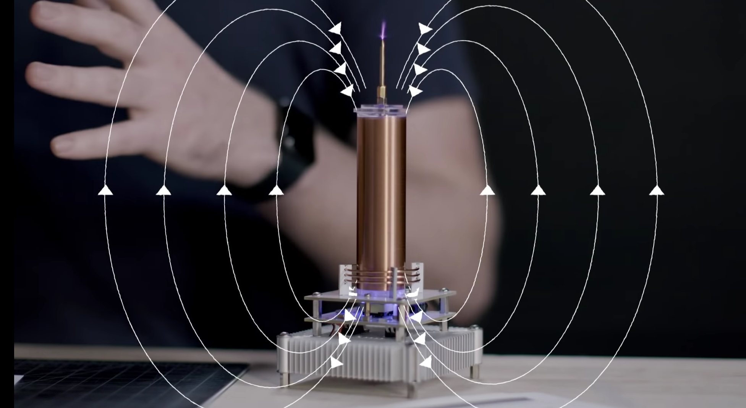
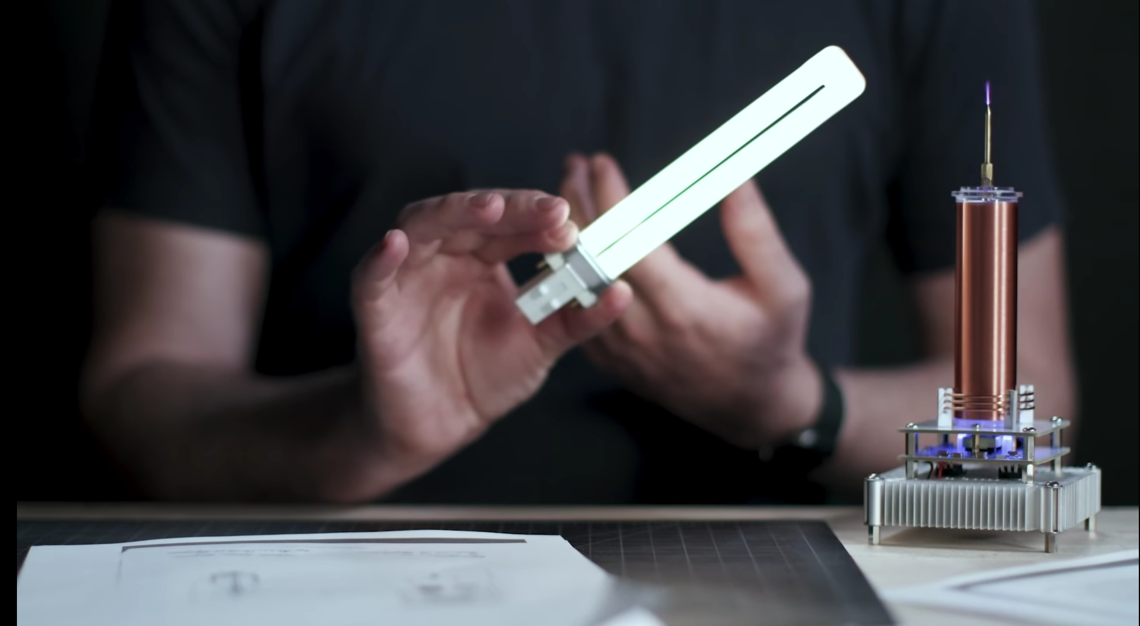
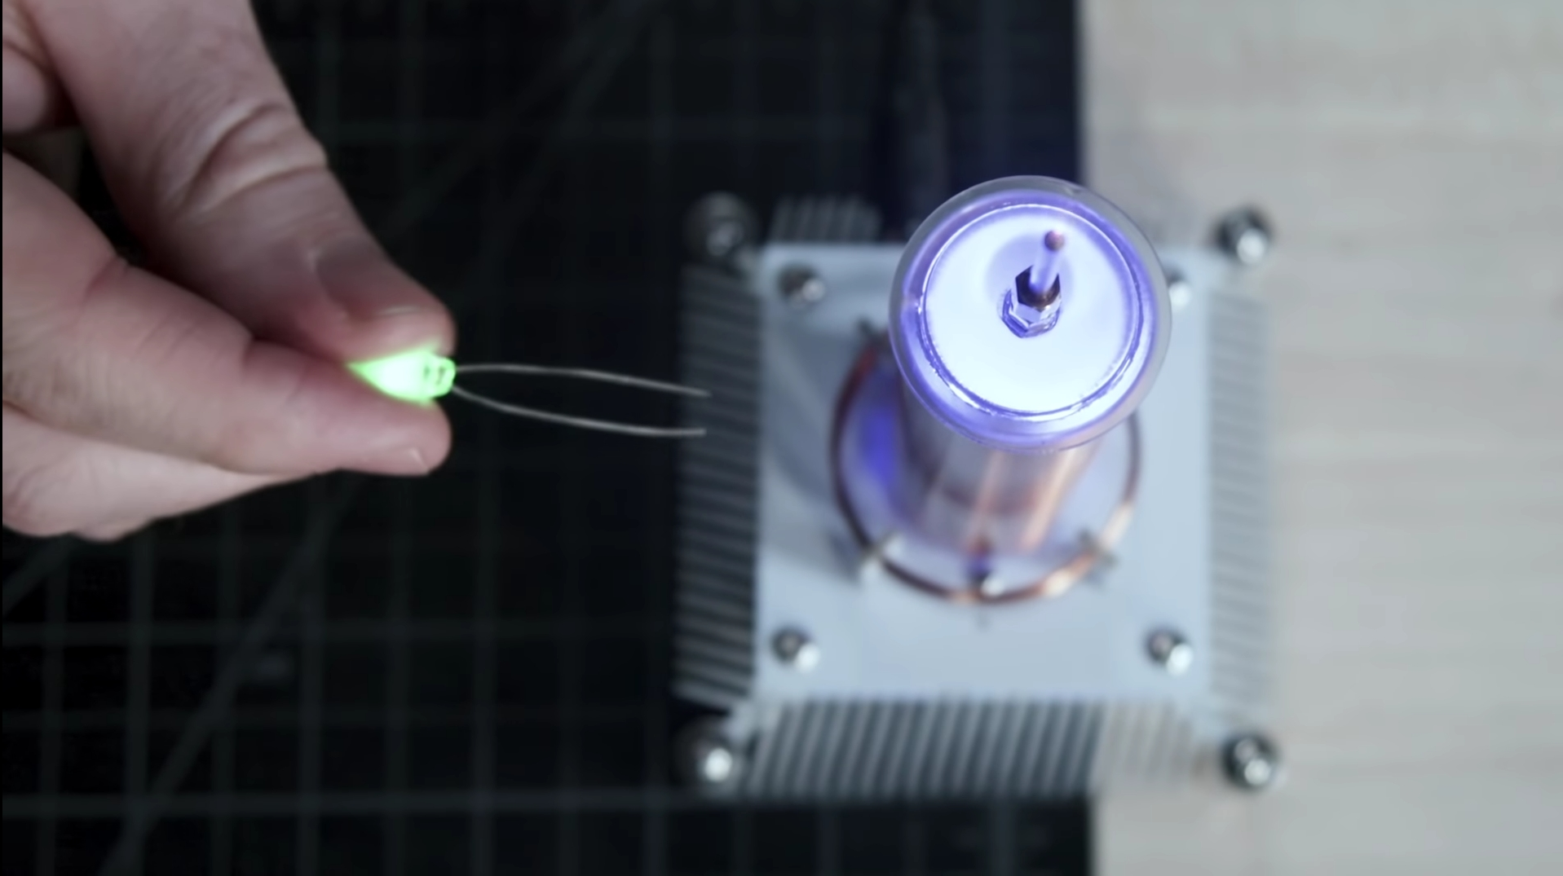
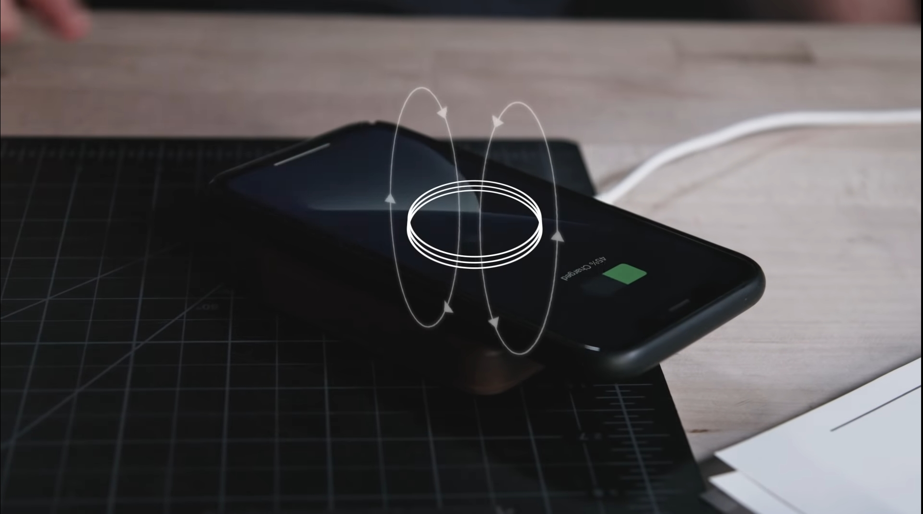

Slide 3
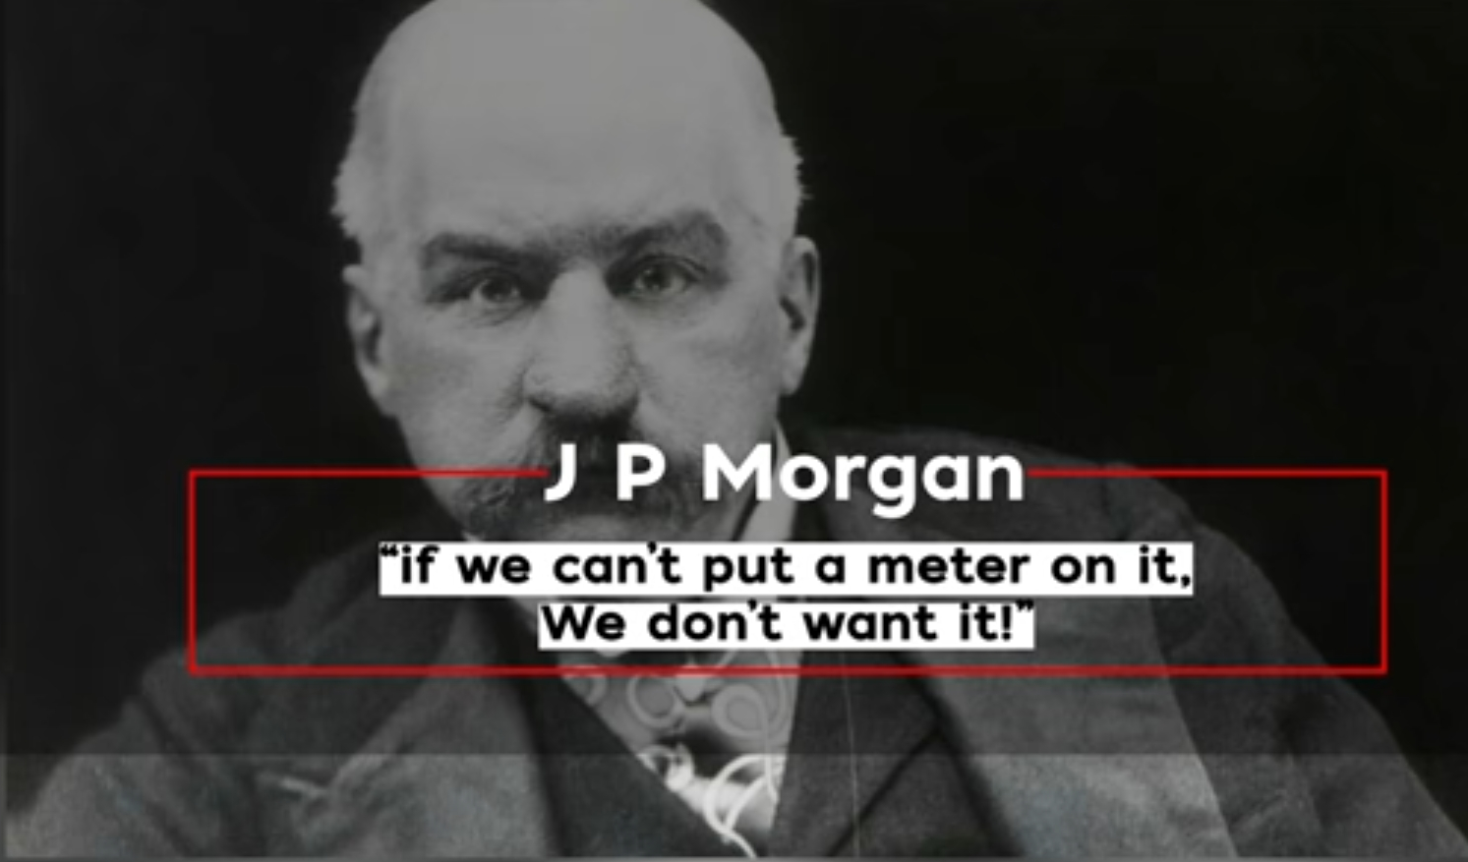
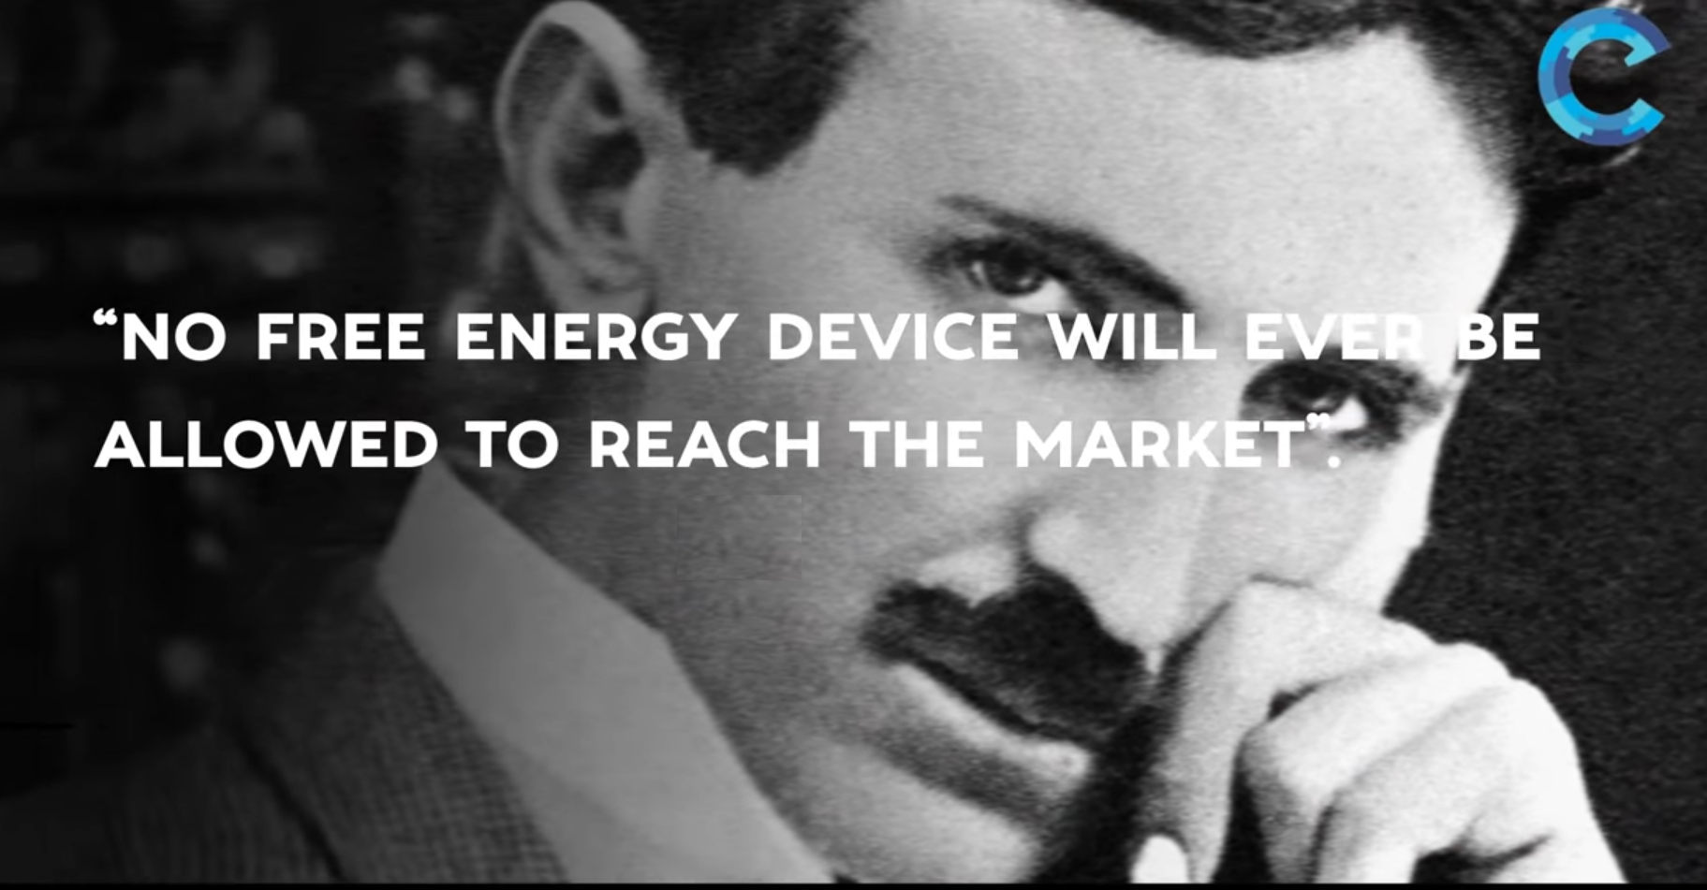
World Wireless… Wardenclyffe… Funding Stopped… radio wars… His mental break down
It is not a dream, it is a simple feat of scientific electrical engineering, only expensive... blind, faint-hearted, doubting world.
-Nikola Tesla 1905, at his 64 age
J.P. Morgan thwarts Nicola Tesla, changed course of history of Free Energy Transmission.

Slide 4
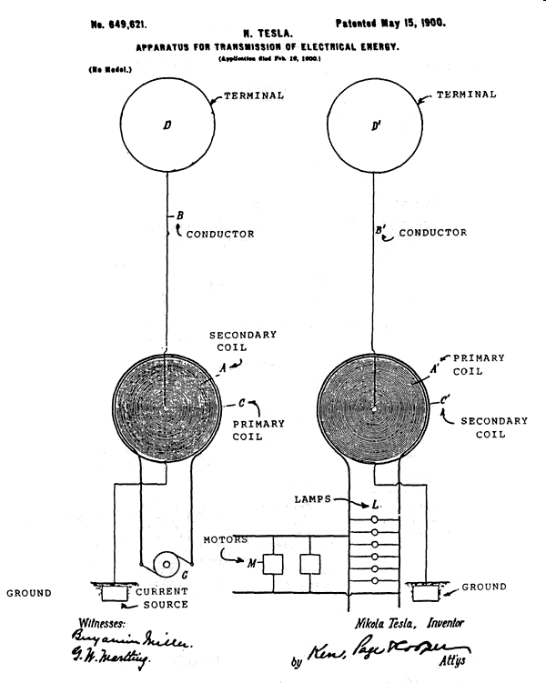
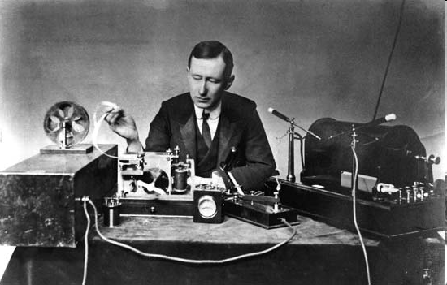
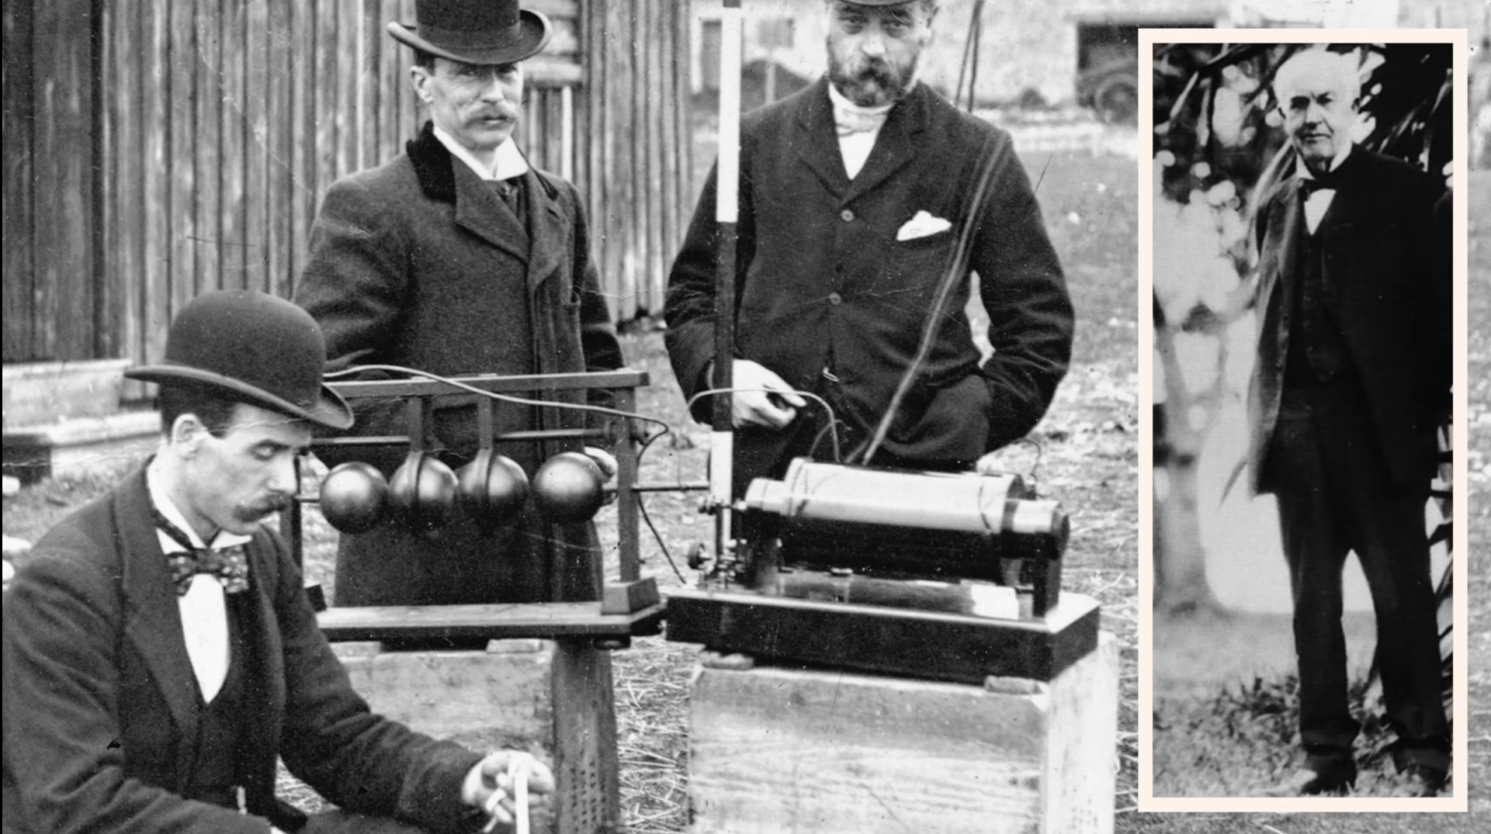
A new competitor in wireless
Marconi is a good fellow. Let him continue. He is using seventeen of my patents. -Nikola Tesla
Edison Did Everything He Could
To Stop Nikola Tesla Succeeding
Tesla submitted early radio patents in 1897

Slide 5
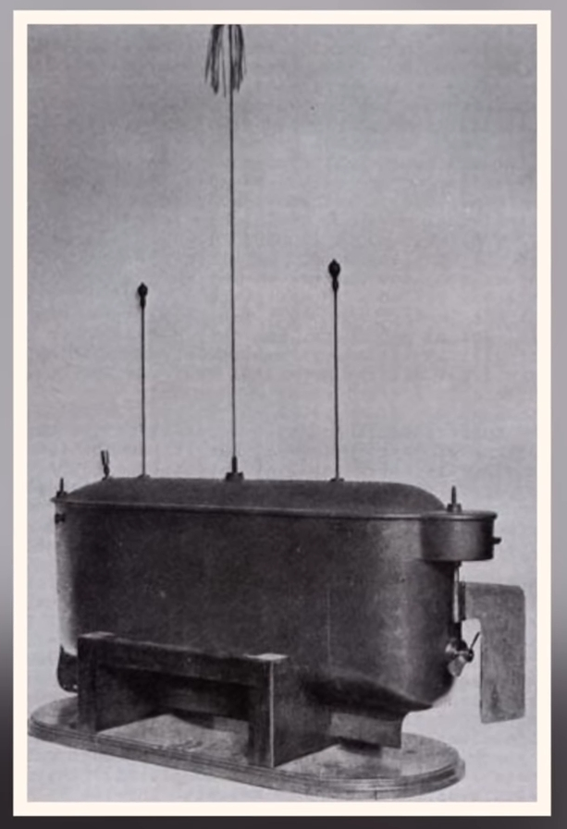
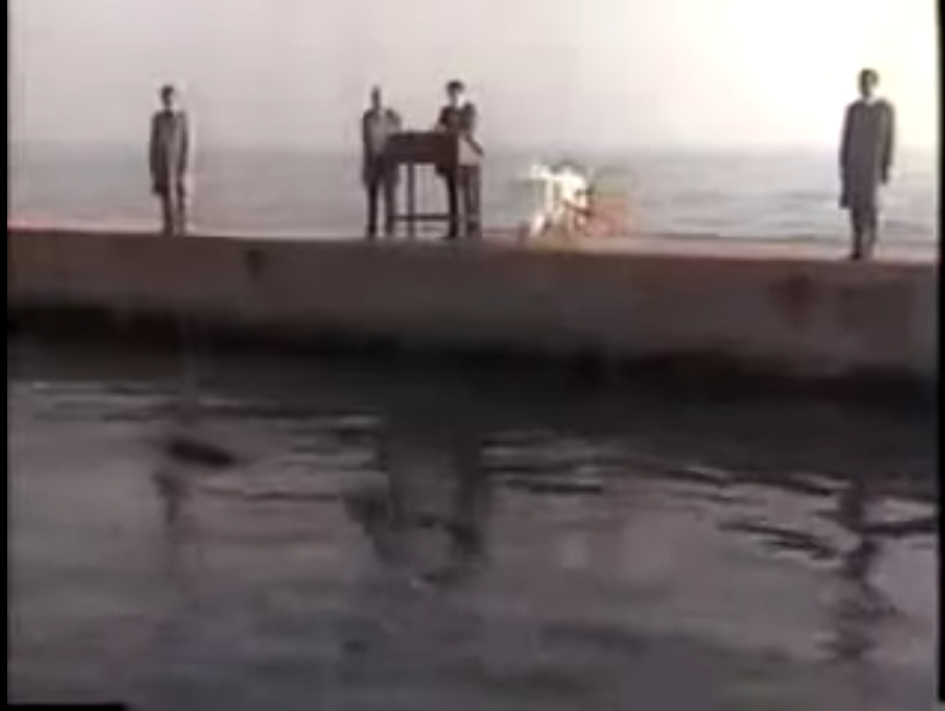
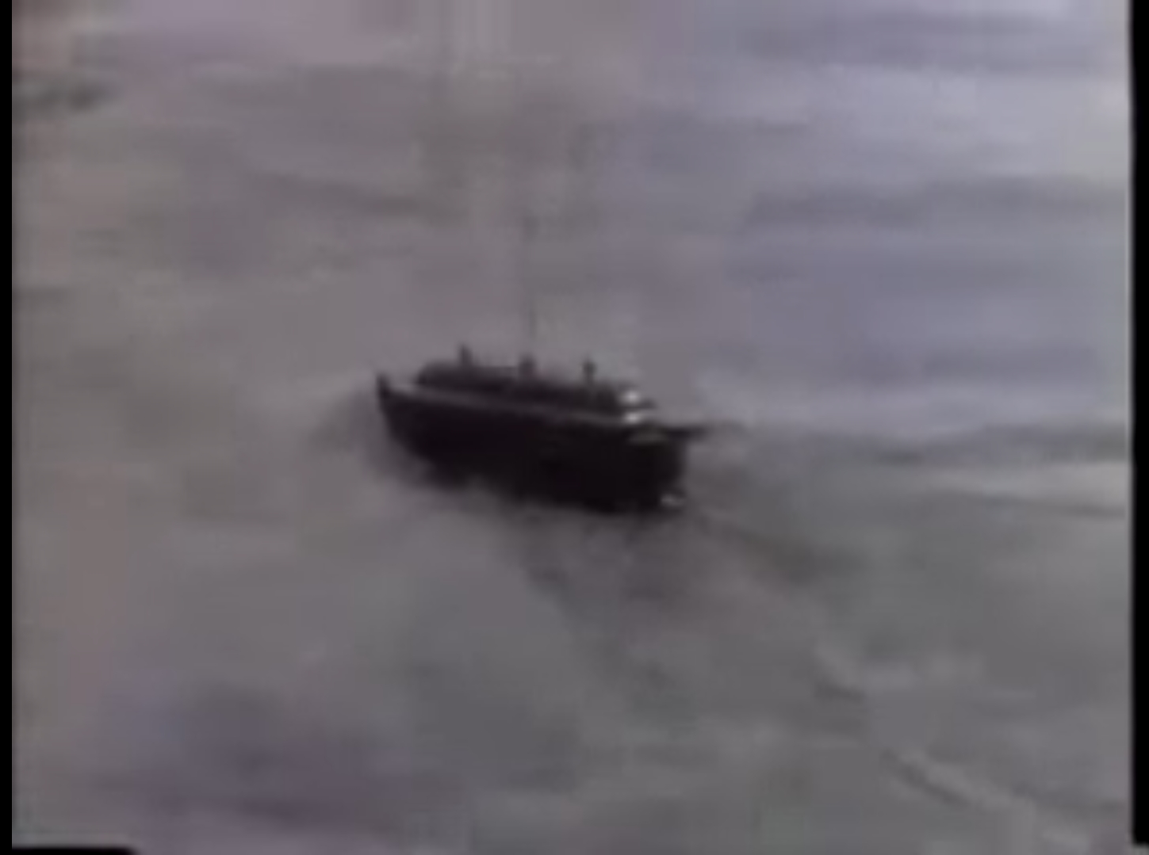
Teleautomaton – First Radio Prototype

Slide 6
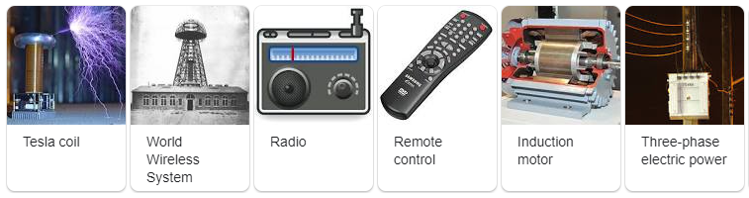
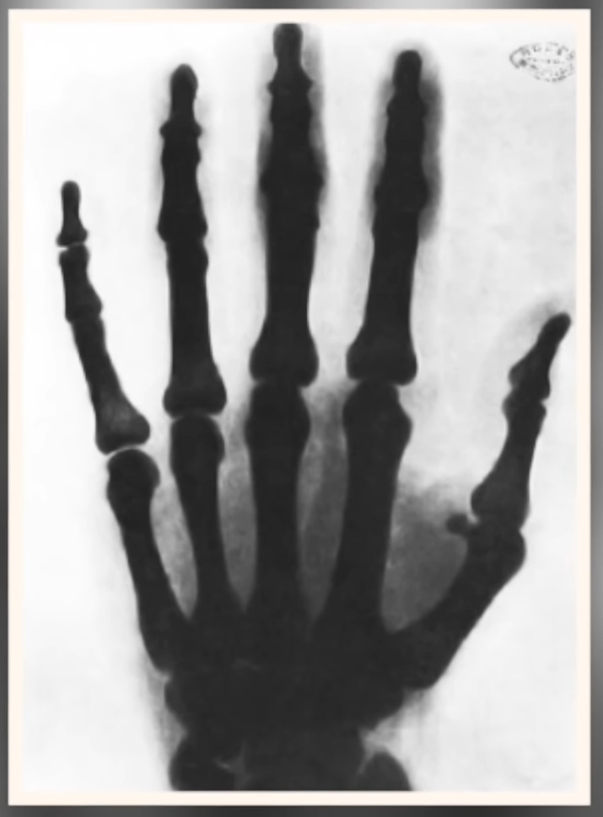
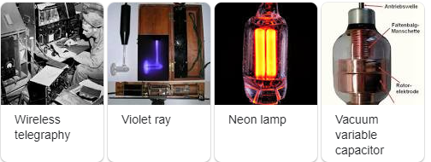
Important Inventions out of his 272 patents

Slide 7
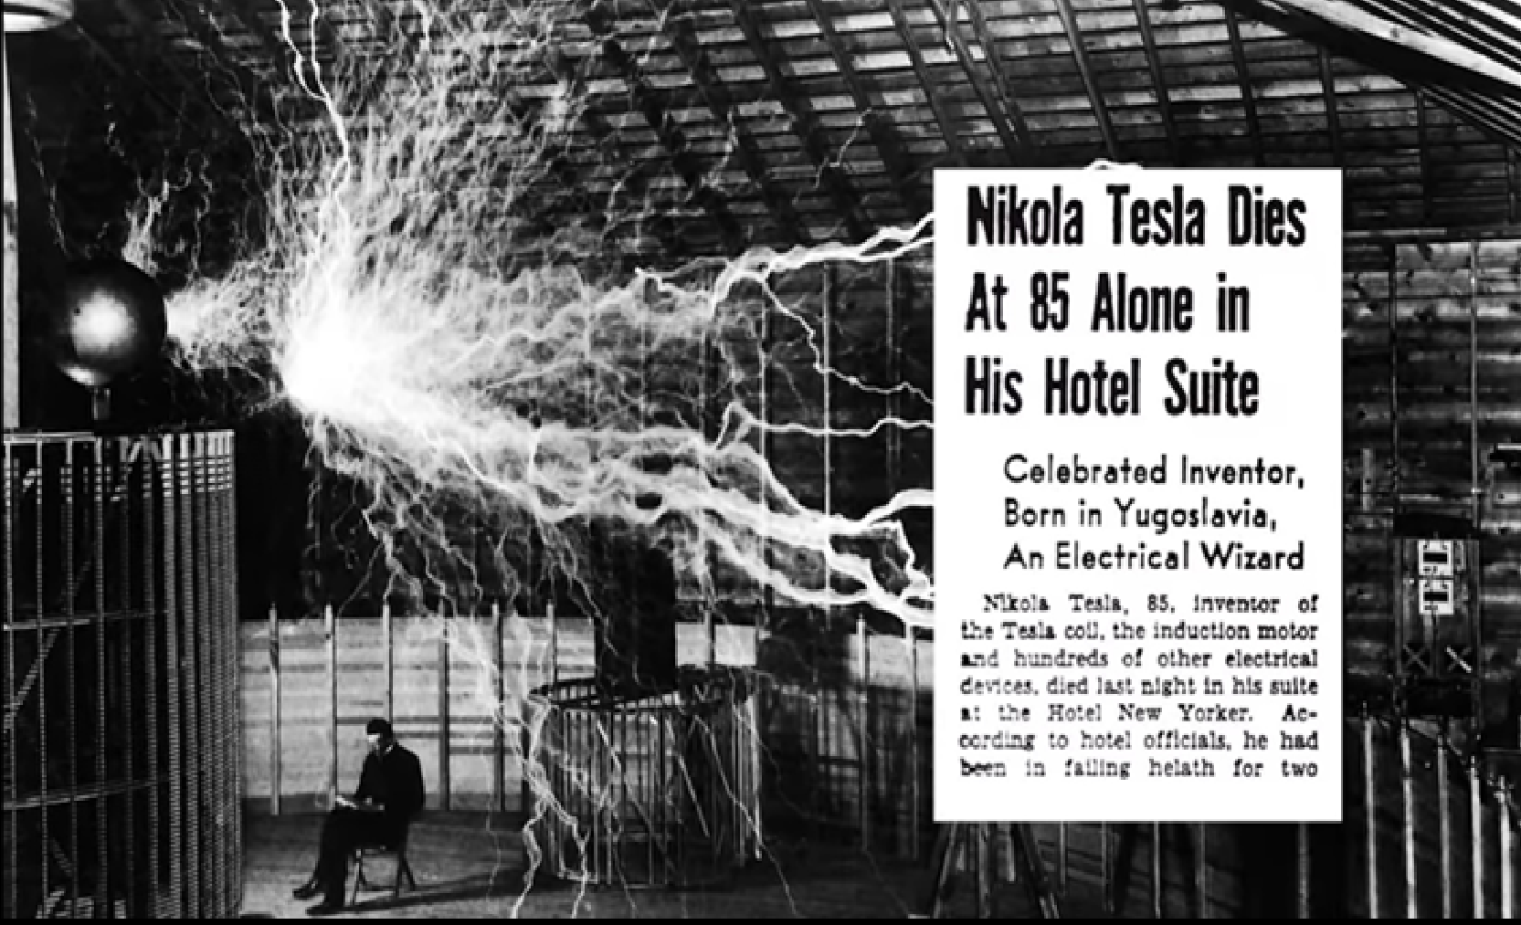
Tesla - Vision of Future Wireless Communication
“ … a telephone subscriber here may call up and
talk to any other subscriber on the Globe. An
inexpensive receiver, no bigger than a watch,
will enable him to listen anywhere, on land or
sea, to a speech delivered, or music played in
some other place, however distant.”
N. Tesla (~1900)

Slide 8
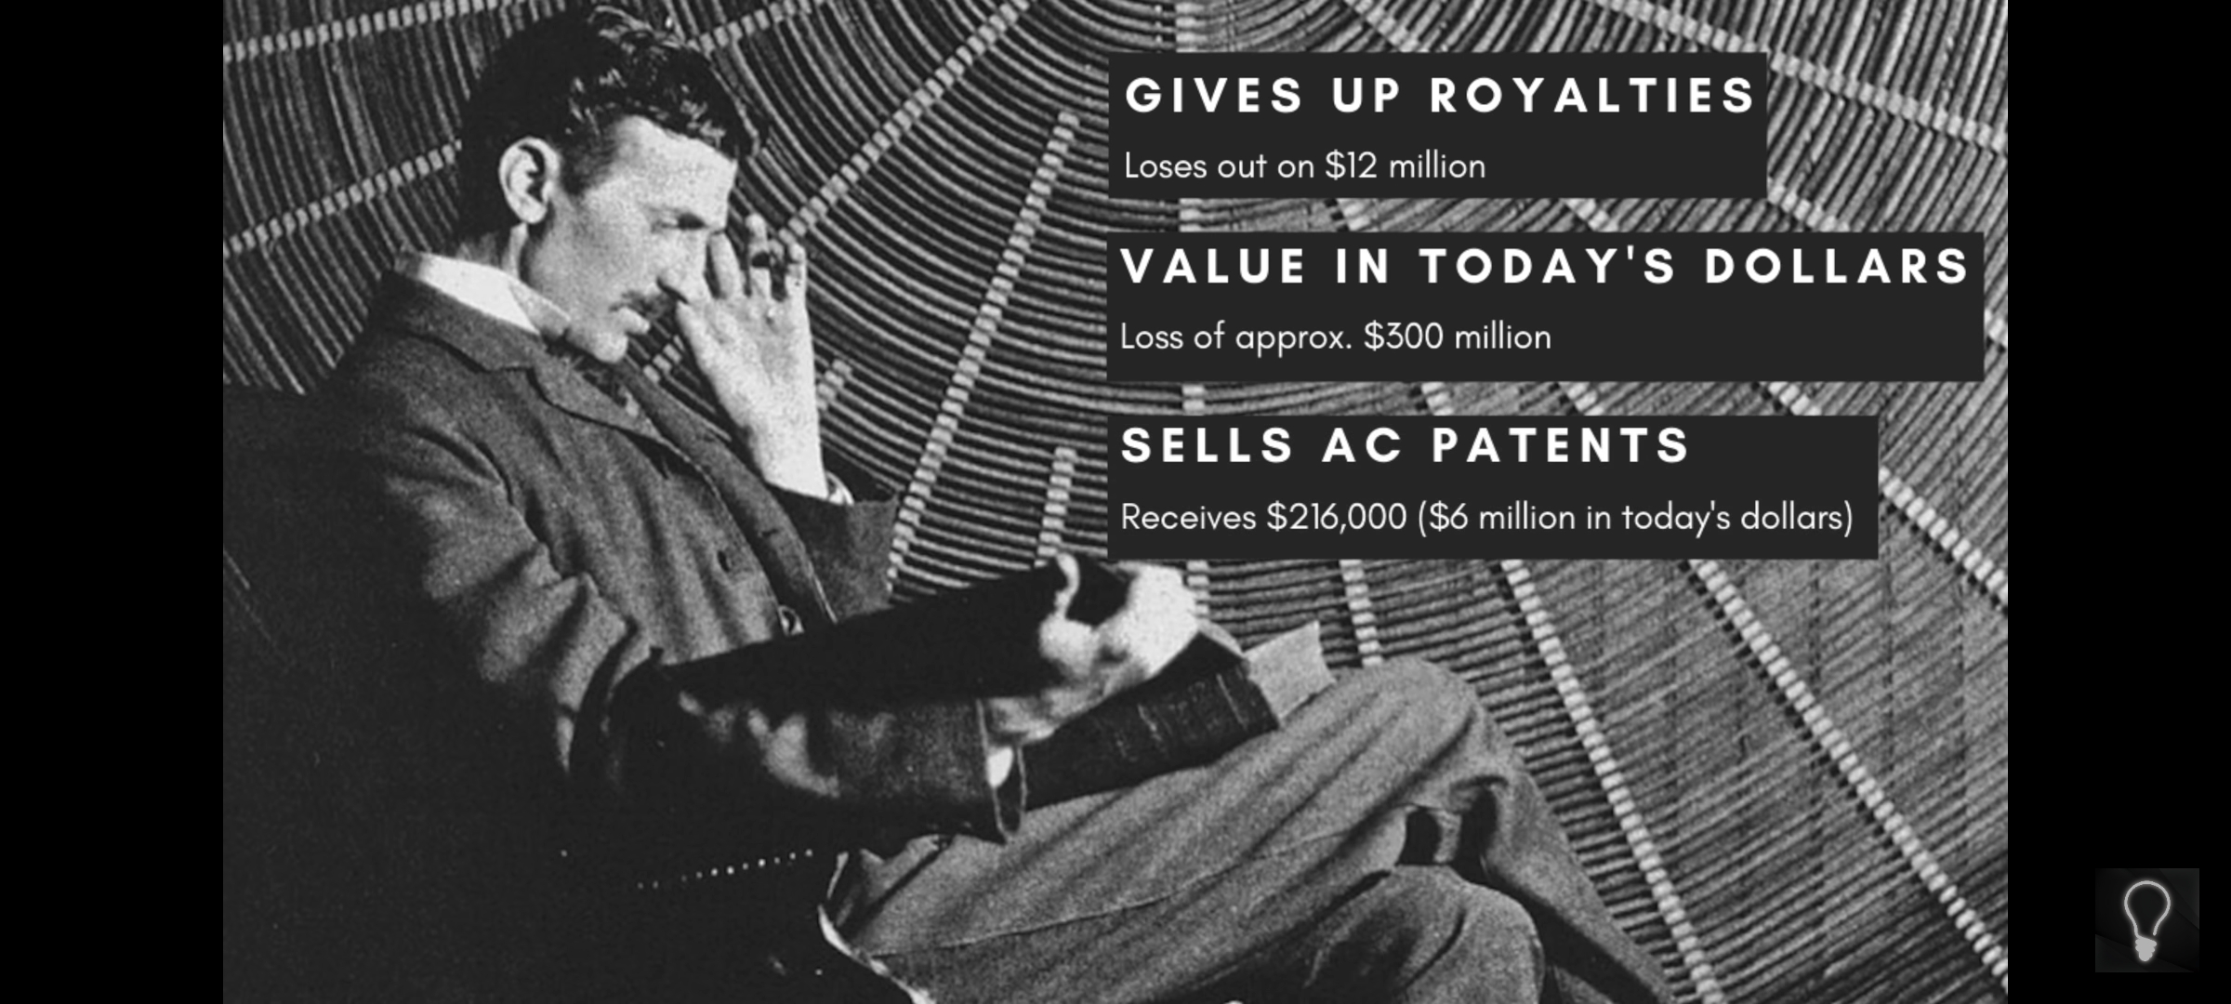

Slide 9
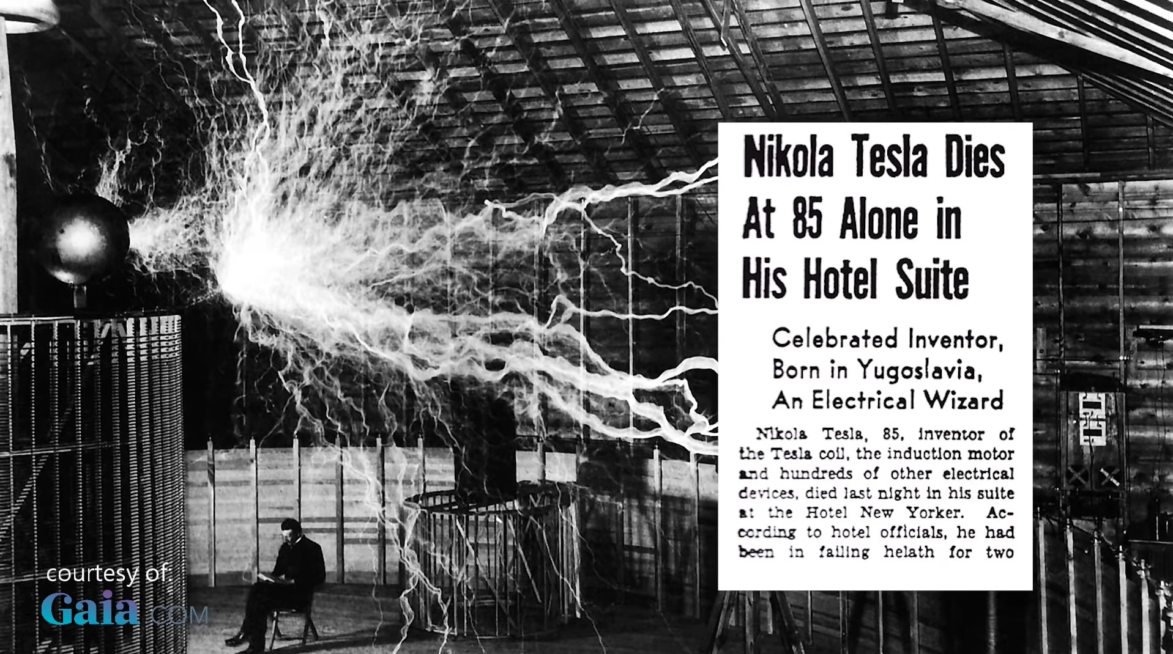
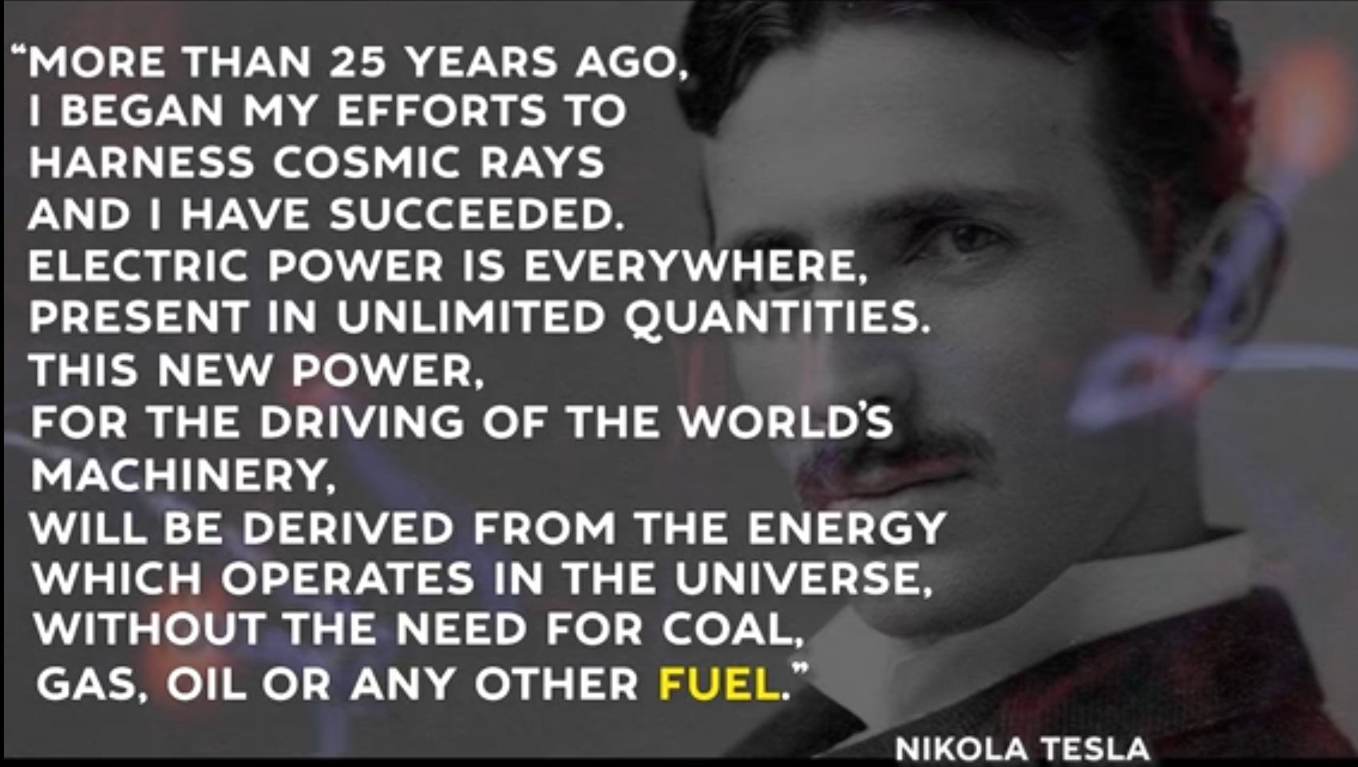
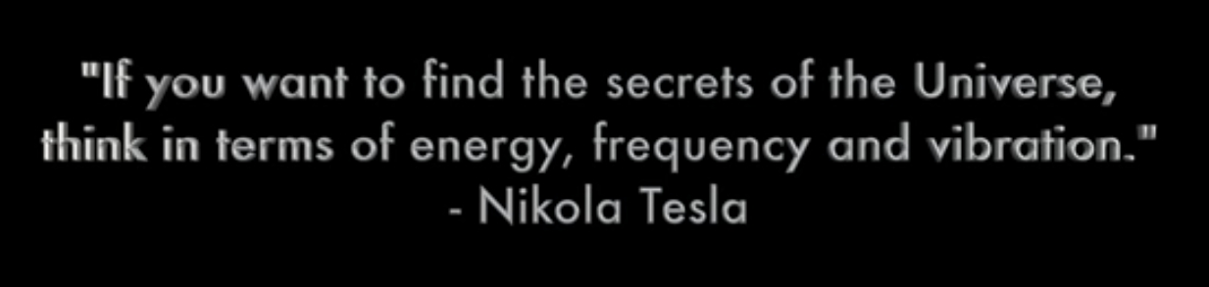

Slide 10
More References:
Nikola Tesla vs Thomas Edison Documentary. “Tesla didn't earn money. He earned respect.”
https://youtu.be/Cidg4Xfpjmc
"I don't care that they stole my idea, I care that they don't have any of their own." -Nikola Tesla
https://youtu.be/pcrwTN5OEZY
Demonstration of Free Energy Car
https://youtu.be/sZ2-p5Zc8qY
Tesla Coil - Wireless Power transmission - Demo
https://youtu.be/z97iOZQd-B4
The Secret of Nikola Tesla The Movie, 1980
https://youtu.be/-EZepGGXPe8
https://youtu.be/FNUY9zS6lDY
Nikola Tesla - Free Energy (fuel free system - How does it works?)
https://youtu.be/YH_LjMdYC_U

